Slide 1

Sounding Sustainability
Teaching & Learning Symposium
28th May 2025
Integrating environmental themes into music education
Dr Jonathan Hodgers
  Department of Music
  jhodgers@tcd.ie
Mr Cathal Ahern
Participating student, 2024–25
ahernca@tcd.ie

Slide 2
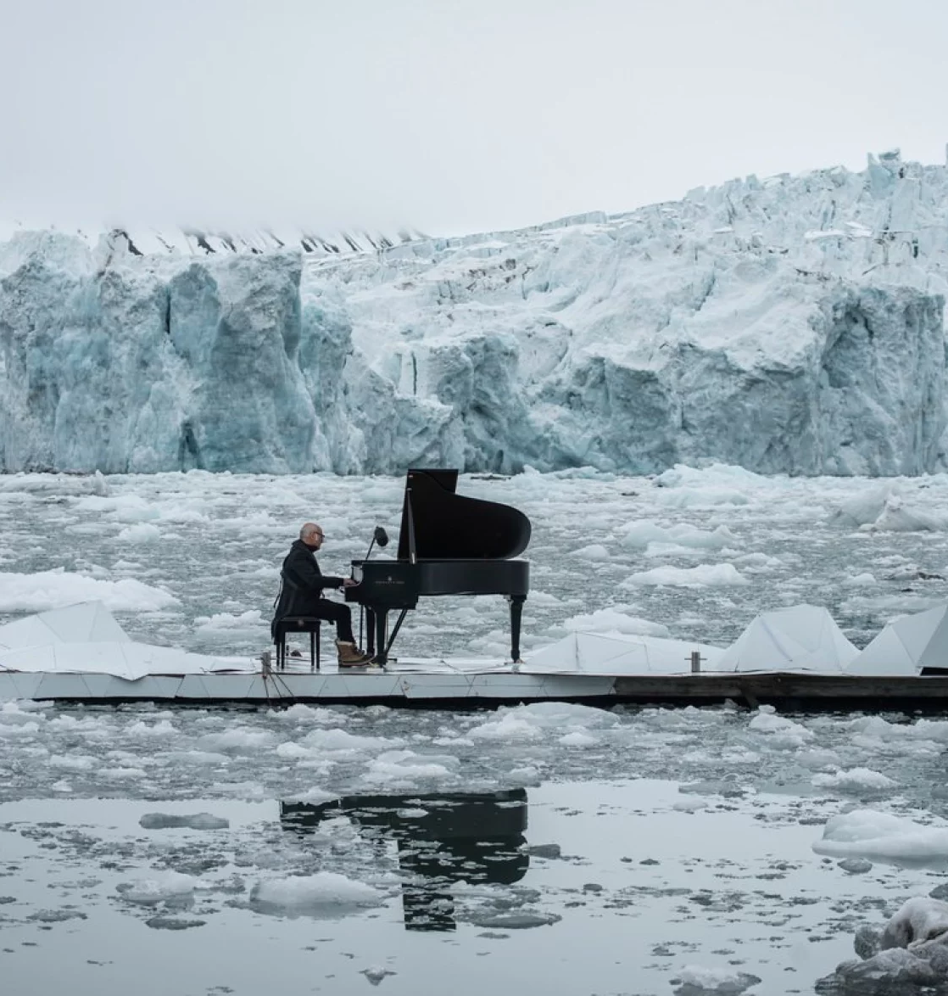
Music and Climate:
The Goals
Explore music’s relationship with climate change
Examine:
  Industry responses (e.g. green touring)
  Musical representations of climate
  Environmental impact of production & streaming
Equip students with industry-specific sustainability insights
Promote ethical reflection & career relevance
Pianist and composer Ludovico Einaudi performs on a melting glacier in 2016 (source here)

Slide 3

SDGs Embedded
Wedding Cake Model in Practice (link)
SDG 4 – Quality Education: Critical thinking & ethical engagement
SDG 13 – Climate Action: Analysing climate themes in music
SDG 12 – Responsible Consumption:
Environmental footprint of music formats
Layered approach across biosphere, society & economy

Slide 4
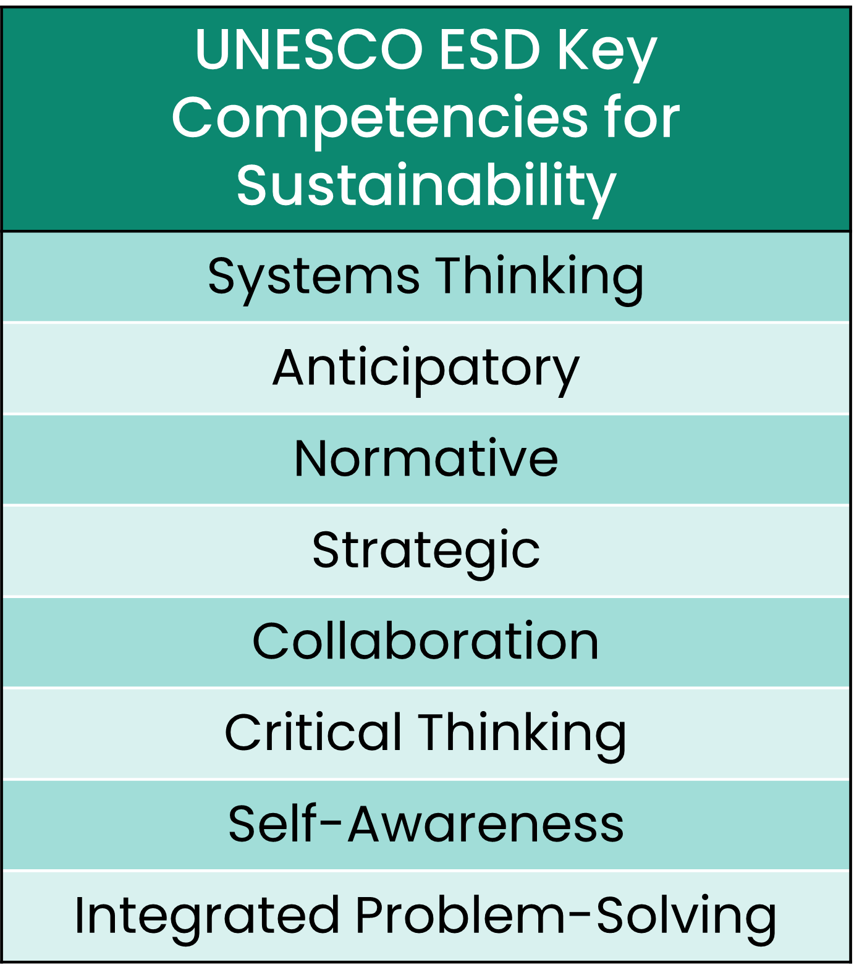
UNESCO ESD Competencies
Embedded through learning outcomes:
Systems Thinking (ecocriticism)
Critical Thinking (ethical dilemmas)
Normative Competency (values-based analysis)
Strategic & Anticipatory (industry innovations)
Self-awareness & Collaboration (seminars, reflections)

Slide 5

Teaching & Assessment Strategy
Assessment | Weighting | Notes
Essay Topic (100w) | 5% | Research planning
Presentation (6mins) | 20% | Short, structured oral delivery + audio-visual element
Essay (1200w) | 55% | Deeper engagement with presentation topic
Viva | 20% | Oral defence & synthesis (antidote to over-reliance on AI)

Slide 6

Applicability Beyond Music:
Embedding ESD Across Disciplines
Three layers of engagement—address how the discipline represents, participates in, and responds to the climate crisis.
Ecocritical Analysis: Explore how environmental themes are represented in texts, media, or cultural practices.
Infrastructure & Impact: Examine the material conditions of the discipline—its production, dissemination, and ecological footprint.
Industry Practices: Investigate current efforts to make the field more sustainable and climate-conscious.

Slide 7

Student’s Perspective on Music & Climate
🧠 Pre- and post-module understanding.
🎵🌍Recognising the interplay between music and climate.
⚠️🎤Highlighting challenges facing the broader music industry.

Slide 8
UNESCO ESD Competency Integration Examples
Systems Thinking – Fostering a holistic view on music and climate’s interconnected nature via ecocriticism.
Critical Thinking –
Reflection on sustainability responsibilities of those in music.

Slide 9

Thank you for listening!

