Slide 1


Visual narratives: exploring the concept of ‘home’ through imagery
Rachel Hoare and (Marie-) Bernadette Rollins
School of Languages, Literatures and Cultures
Centre for Forced Migration Studies

Slide 2
structure
Context of teaching activity
Learning outcomes
Learning environment
Meaning of home activity
Bridging personal learning with academic research
Learning sequence
Learning by doing
Inductive approach
Bernadette’s student experience

Slide 3
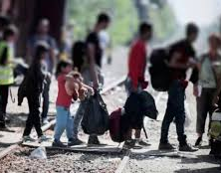
Context of teaching activity ‘The meaning of home’
Module: ID7019 Forced Migration and Identity: Reconstructed and Reimagined Futures
Participants: 10 Masters students from programmes in SLLCS:
  Identities and Cultures of Europe
  Comparative Literature
  Literary Translation
Delivery: Interactive, experiential dynamic lecture

Slide 4
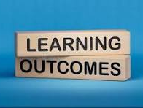
Upon completion of this activity, students will be able to:
Demonstrate empathetic understanding of displacement experiences through personal reflection and connection to refugee narratives
Critically analyse the multifaceted concept of "home" across different cultural contexts using both experiential and theoretical frameworks
Evaluate the psychological and emotional impact of forced migration on individual and community identity
Recognise the potential of visual narratives as tools for understanding and exploring concepts of home and displacement

Slide 5
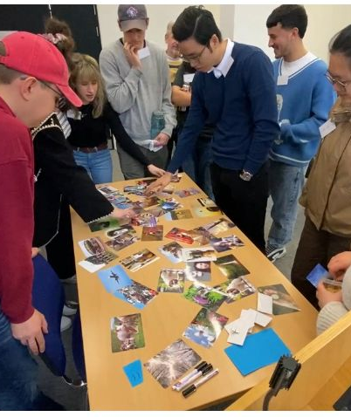
Physical Learning Environment for exploring the concept of home
Room Configuration:
Informal setup to encourage participation
Chairs arranged in horseshoe formation
Open central space for students to circulate
Large front table displaying picture cards
Purpose: Create welcoming, interactive learning space

Slide 6
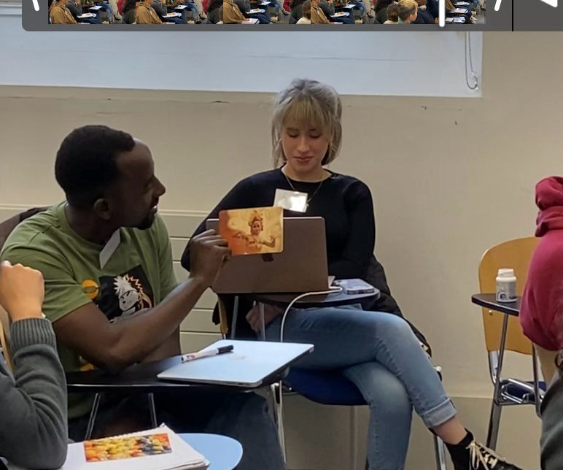
‘Meaning of Home’ ACTIVITY
Activity Overview:
Students choose cards representing "home"
Students reflected on home concepts in pairs
Connection to refugee lived experiences (including those participating in a panel discussion)

Slide 7

Bridging personal understanding with academic research and media representations using UDL principles
Reading:
Journal of Refugee Studies article
Focus: Syrian refugee narratives
Topic: Constructing home in Greece
Viewing:
Youtube video: Refugees discuss the meaning of ‘home away from home’
Listening:
BBC Crossing Continents podcast on the refugee concept of home

Slide 8


Learning sequence
Step 1: Personal reflection through card selection
Step 2: Connect to refugee experiences
Step 3: Link to academic research and media representations
Step 4: Introduction of theoretical frameworks
Goal: Build understanding progressively from experience to theory

Slide 9
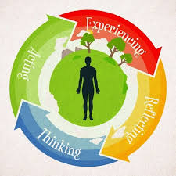
Learning Approach: "Learning by Doing"
Core Philosophy:
Experiential engagement to deepen learning
Hands-on experiences combined with reflection
Connect personal experiences to refugee experiences

Slide 10
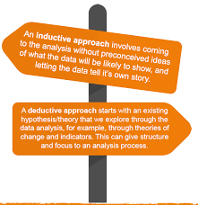
Inductive Learning Approach
Process:
Students explore personal experiences first
Connect own experiences to refugee narratives
Move from specific examples to general concepts
Rationale: Empower deeper thinking about forced displacement (what it is like to lose your home and to experience other losses) before introducing theoretical frameworks

Slide 11
Bernadette’s Student Experience
immediate visual associations; deeper layers of association emerged in conversation
chain of memories that lay 'dormant’
cards evoked more temporal depth than verbal prompts
served as preparation/empathy-priming for listening to the testimonies on the panel discussion
learning outcome: visual cues are powerful prompts for memories and associations with 'home’
activity illustrated active, individual-centered recollecting; suitable for trauma-informed practice and other stream-of-consciousness exercises

