Slide 1
Using GenAI to transform teaching methods and enhance students' learning outcomes in Children’s and General Nursing students
Lisa Kirwan and Tracey O’Neill
School of Nursing and Midwifery

Slide 2
Overview
Goal of the activity
Implementation
Successes and areas for improvement
Lessons for future practice

Slide 3
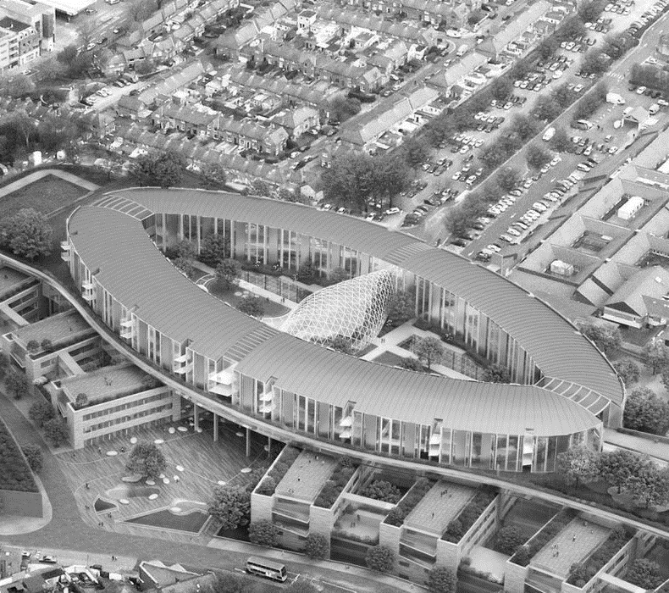
Goal of the Activity
Transform teaching methodology and student learning outcomes.
Develop digital literacy.
Enhance critical and analytical thinking.

Slide 4
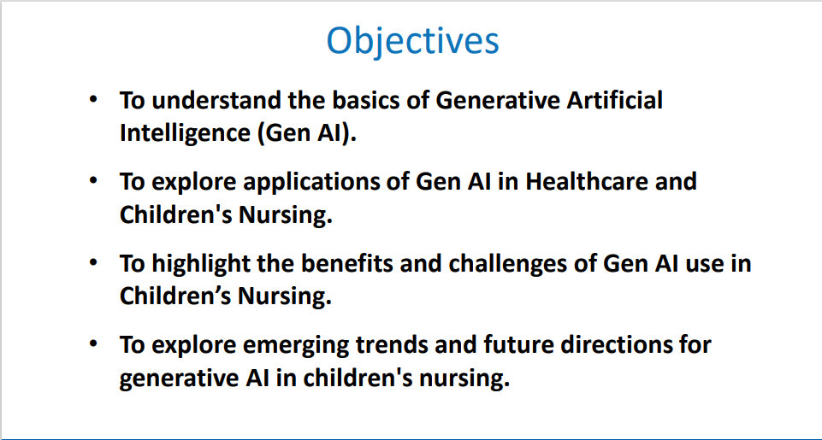
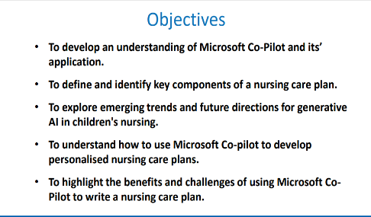
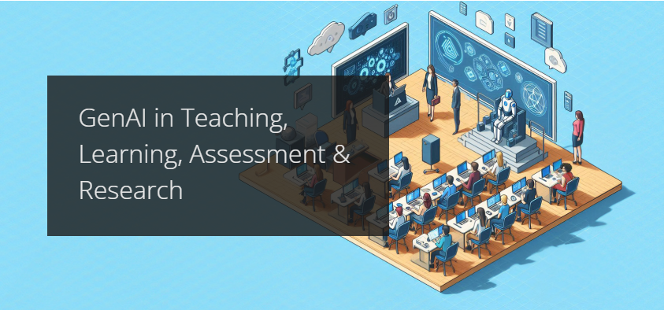
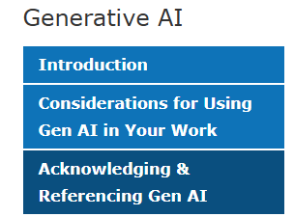
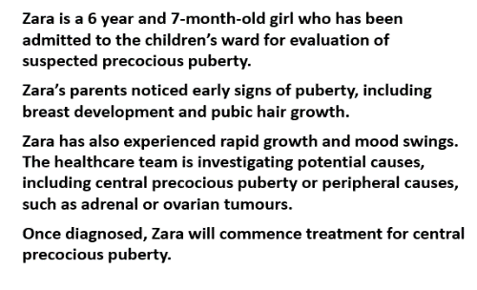
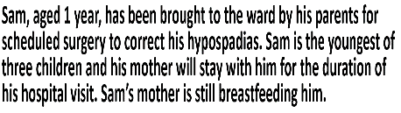
Implementation
Introduction to Gen AI
Clinical Scenarios
Gen AI-assisted nursing care plan
Resources
Critical reflection and evaluation
Feedback

Slide 5
How Successful Was It?
Implementation challenges
User-friendly
Content reliability
Innovative format

Slide 6
What Will We Change?
Delivery
Format
Supportive materials
Iterative Improvement

Slide 7
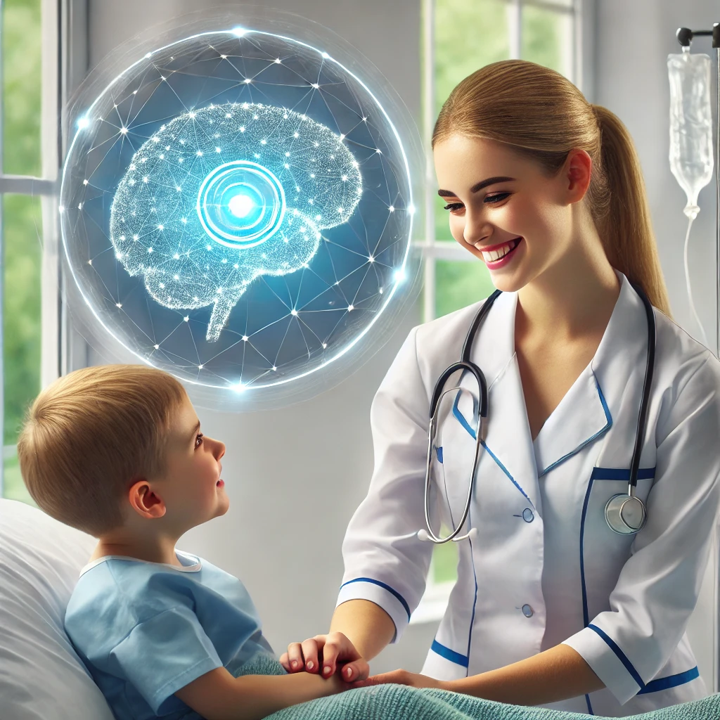
Conclusion
Objective
Approach
Outcomes
Next Steps
Image created by DALL.E OpenAI Image generator

Slide 8
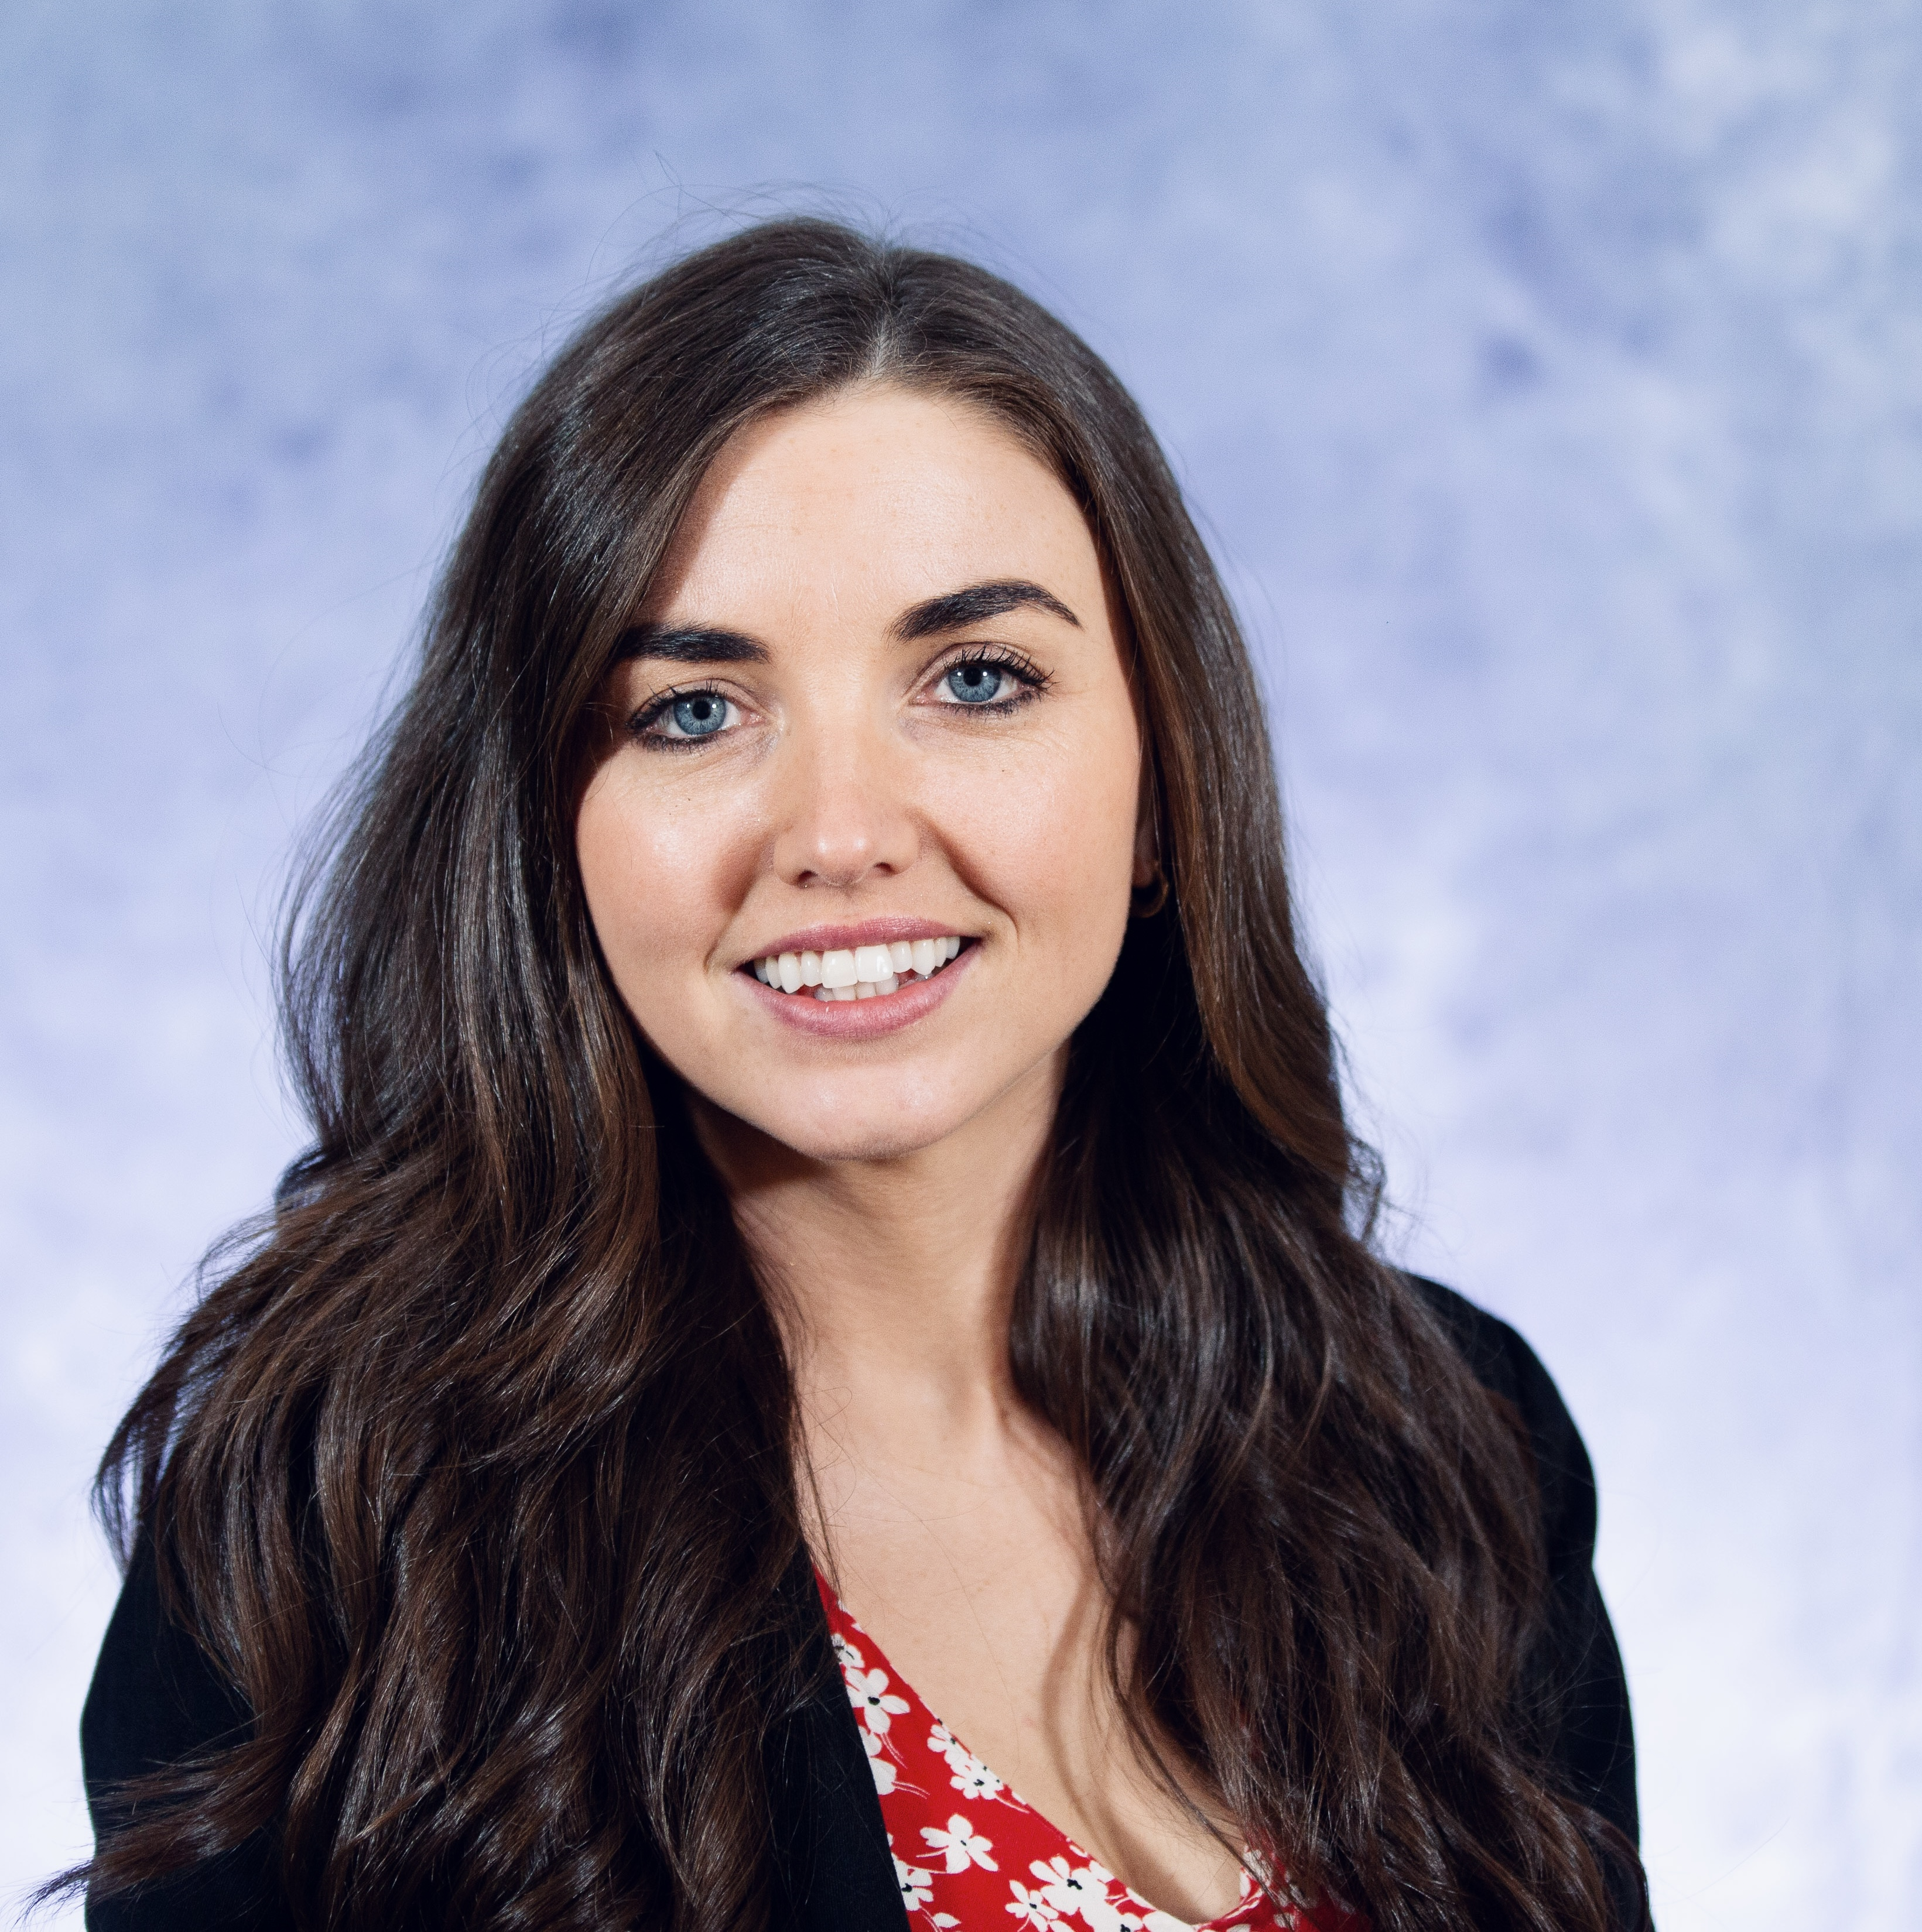
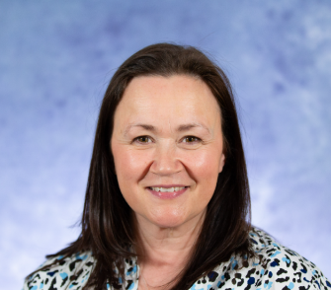
Thank You for Listening
Contact us:
Lisa Kirwan
Email: kirwanl4@tcd.ie
X: @lisakirwan3
Tracey O’Neill
Email: troneill@tcd.ie
X: @traceyoneill7

