Slide 1
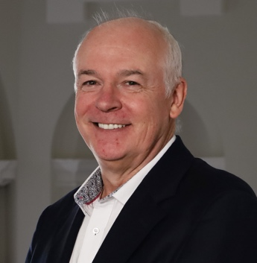
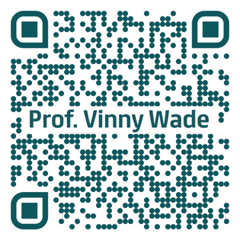
Update on Teaching and Learning In Trinity
Prof Dr Vincent Wade BSc., MSc., MA., PhD., FTCD
Professorial Chair of Computer Science (Est. 1990)
CoFounder, ADAPT SFI Research Centre
Dean of Undergraduate Studies and The Senior Lecturer
West Theatre
Trinity College Dublin, University of Dublin
SLecture@TCD.IE

Slide 2

Outline
Update on Teaching & Learning Supports in Trinity
GenAI in Trinity
Learning Research & Innovation Hub
Opportunities to Engage:
Call for Expression of Interest in Learning Innovation Project(s)
Notes:
Identify opportunities, potential uses and potential impacts
Recognise how GenAI works and what impact it can have
Identify & Discuss existing use cases of GenAI in business tasks and processes.
Recognise the key challenges and risks in current GenAI services
Identify typical approaches in operationally and strategically utilising GenAI in organisations
Generative AI in Education
Potential Impacts of Generative AI
Improved Productivity of L&D teams?
Enhanced Learner autonomy via Improved access & Personalisation Learning?
Dilemmas in Generative AI
The assessment dilemma
What new learning opportunities?
personalized and customized learning?
Next Generation AI enhanced Learning

Slide 3
1. GenAI in Trinity

Slide 4
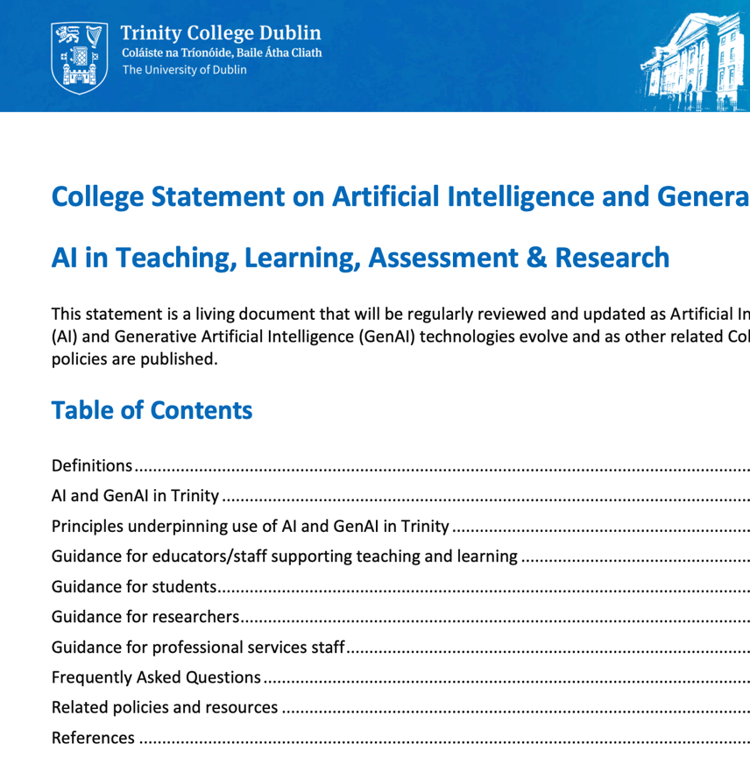
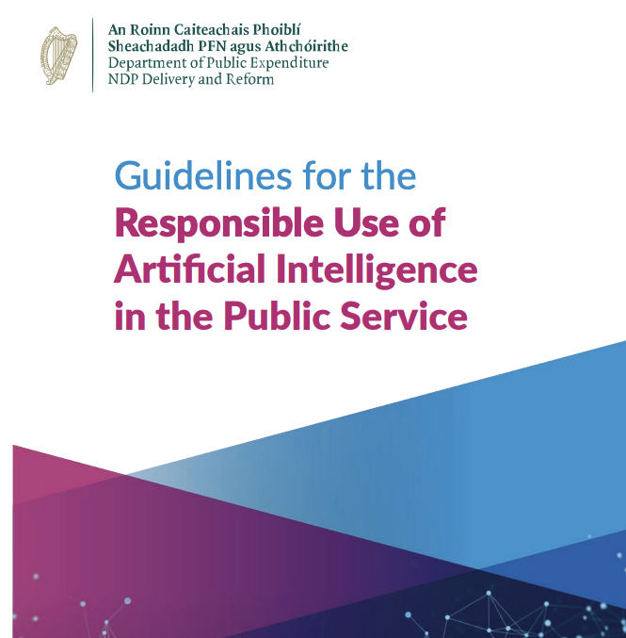
Trinity GenAI Statement
Public Service Guidelines

Slide 5
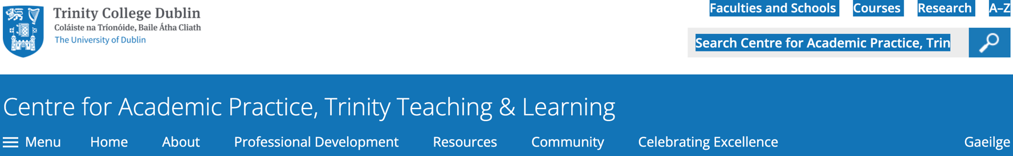
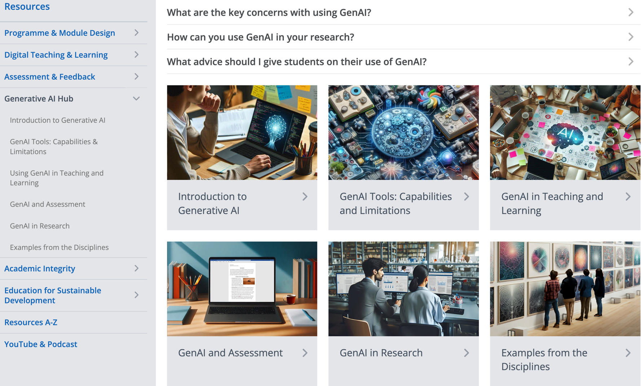

Slide 6
Learning Research and Innovation Hub

Slide 7
Teaching and Learning in Trinity
Vice-Provost/
Chief Academic Officer
Exec Director of
Academic Services Division
Senior Lecturer/
Dean of Undergraduate Studies
Dean of
Graduate Studies
Academic Secretary
Academic
Affairs
Centre for Academic Practice
Careers &
Development
Enterprise Engagement
Quality
Office
Learning Research & Innovation Hub
Trinity Access
Programme
Graduate
Studies

Slide 8
Teaching and Learning in Trinity
Vice-Provost/
Chief Academic Officer
Exec Director of
Academic Services Division
Senior Lecturer/
Dean of Undergraduate Studies
Dean of
Graduate Studies
Academic Secretary
Academic
Affairs
Centre for Academic Practice
Careers &
Development
Enterprise Engagement
Quality
Office
Learning Research & Innovation Hub
Trinity Access
Programme
Graduate
Studies

Slide 9
Pressures on Trinity Curricula and Staff !!!!
Digital transformation
Generative AI & Data Analytics
Inclusion
Sustainability & Climate Change
Student wellbeing
disparities in access to education
Increasing student numbers and diversity
Micro-credentials
Data Analytics Impact of the pandemic teaching and learning
Climate change and sustainability
Graduate employability
4

Slide 10
Learning Research & Innovation Hub
To provide a focus for Teaching & Learning Innovation where College expertise can be aggregated and harnessed
To better devise and/or adopt proven teaching innovations,
To conduct pedagogic research, pilot, and where appropriate, mainstream new developments in curriculum design, teaching practices, learning, and assessment, and
To support the application of new and emerging learning technologies
To enable mainstreaming of appropriate T&L innovation across College
An ALL College Space for experimenting and researching Teaching & Learning Innovation using shared resources and expertise

Slide 11
Maximising impact of existing teaching and learning resources
M
Tutorial Services
Student Services
Library
Student Learning Development
Careers & Development
Academic Practice
Academic Affairs & Quality
Learnovate
EDI /Disability
Inclusive Curriculum
Data Protection Office
Learning Innovation & Research Hub
IT SERVICES
IT Teaching & Learning /
Digital Learning Development
Global
Schools
Tangent / Portal
Martin Naughton –
E3 Learning Foundry
Dean of Students’ Office
5

Slide 12
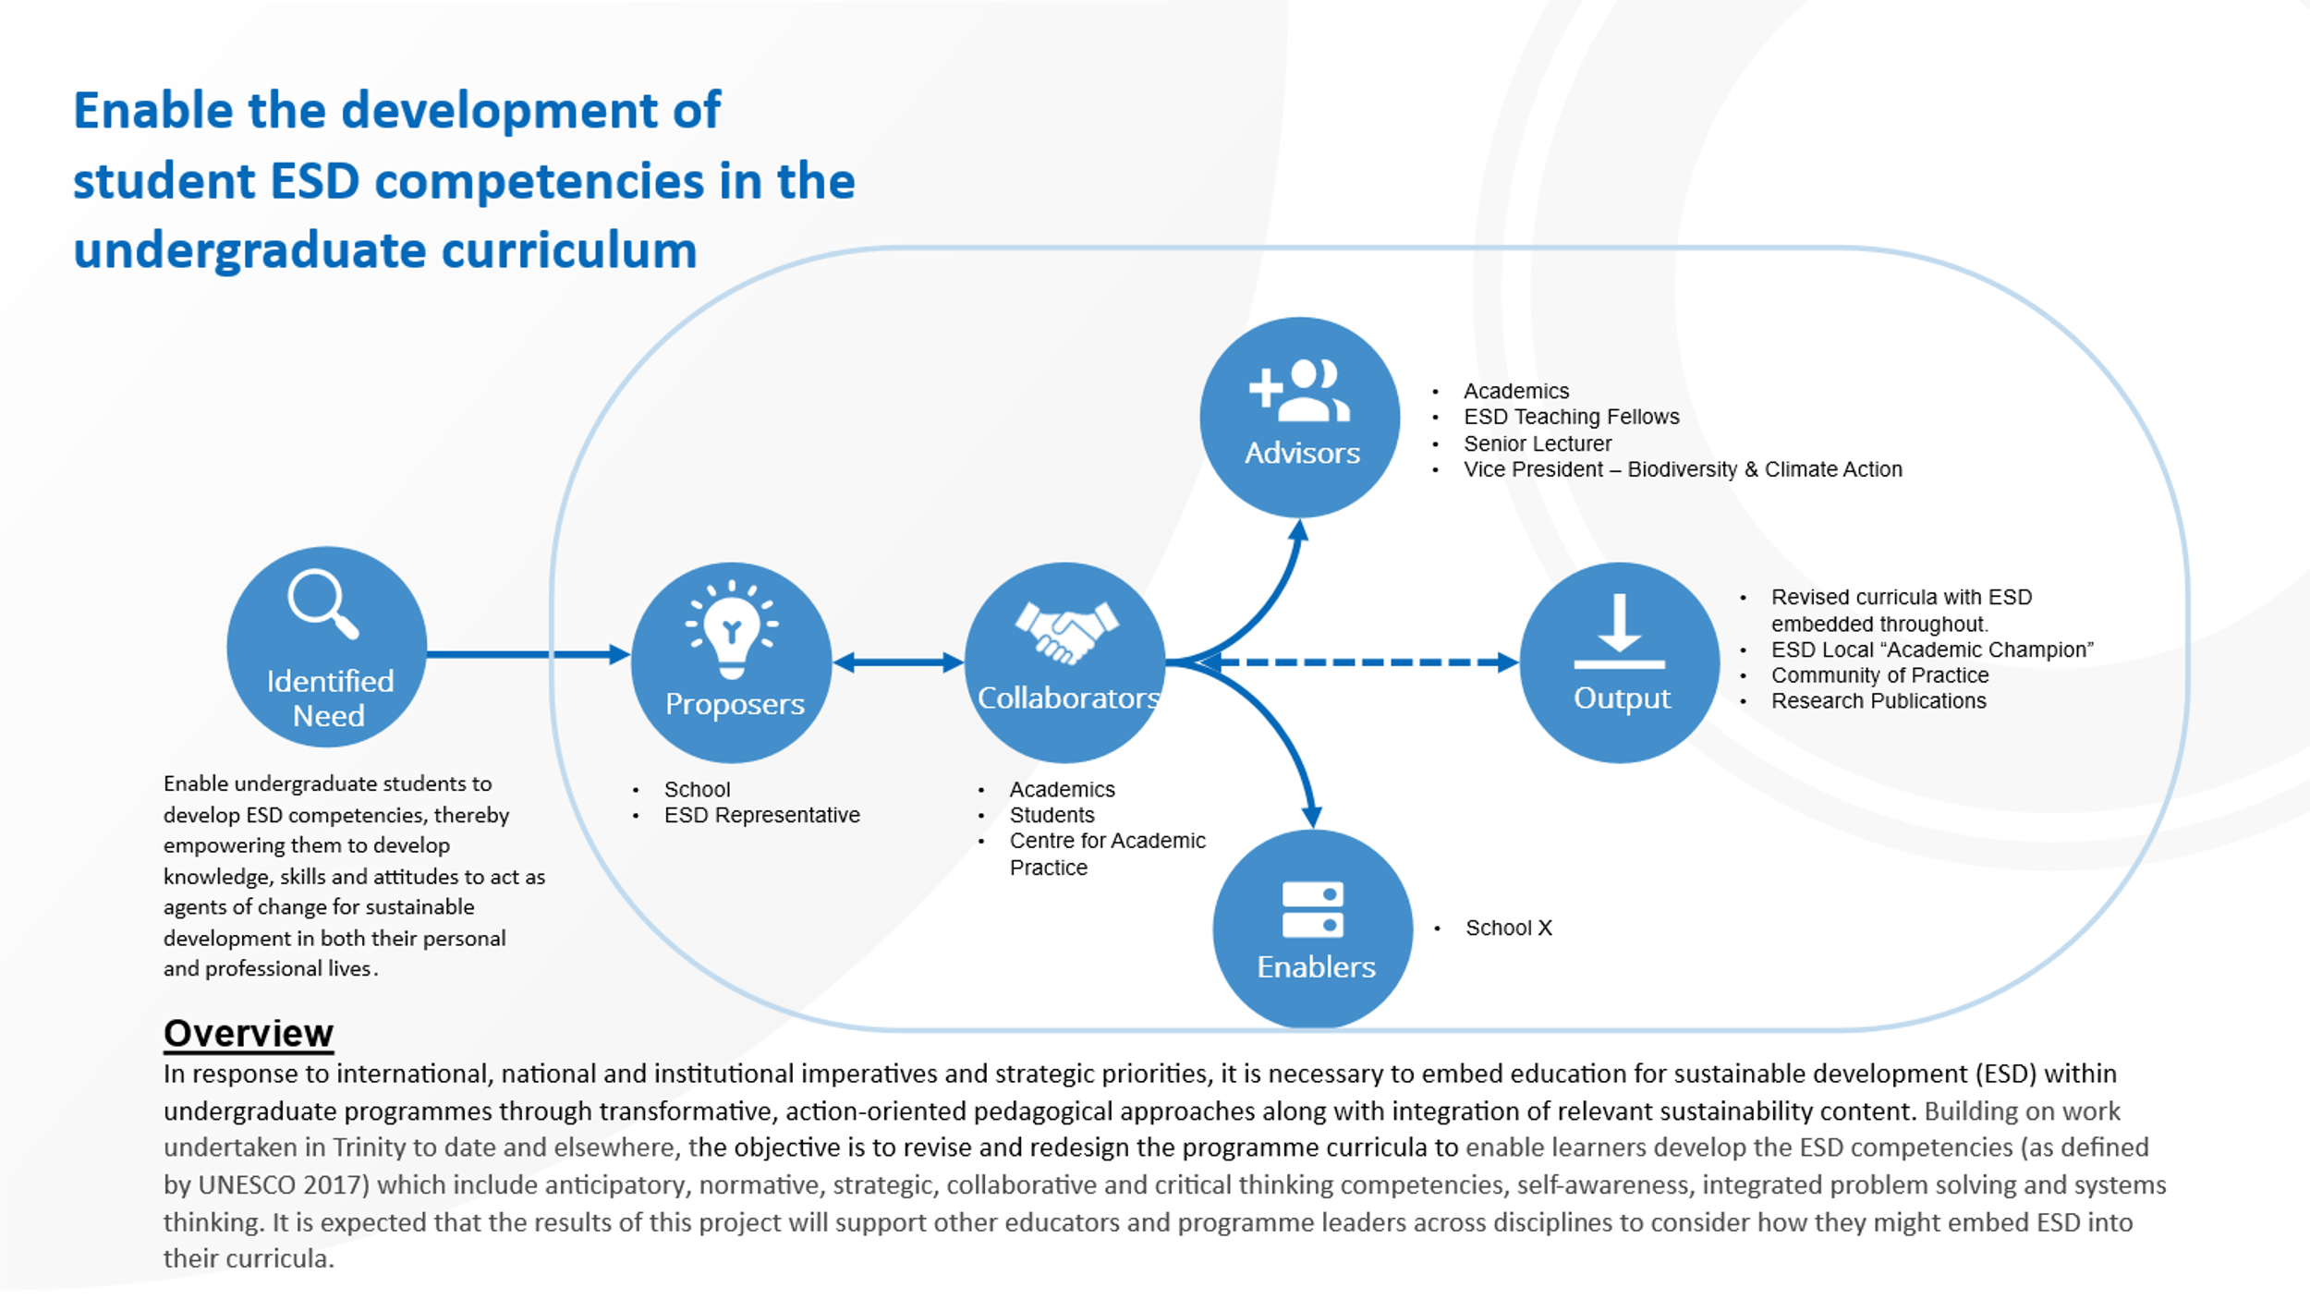
7

Slide 13
2. How to engage:
CALL for Expressions of Interest in Learning Innovation Project(s)

Slide 14
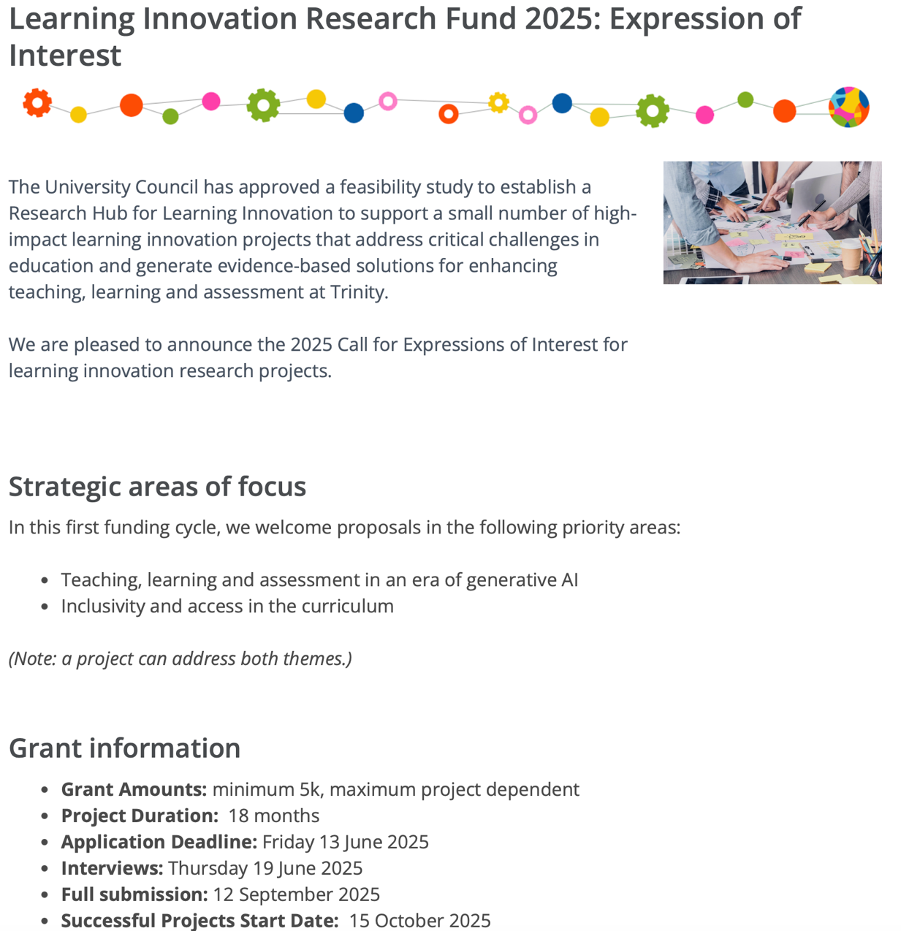
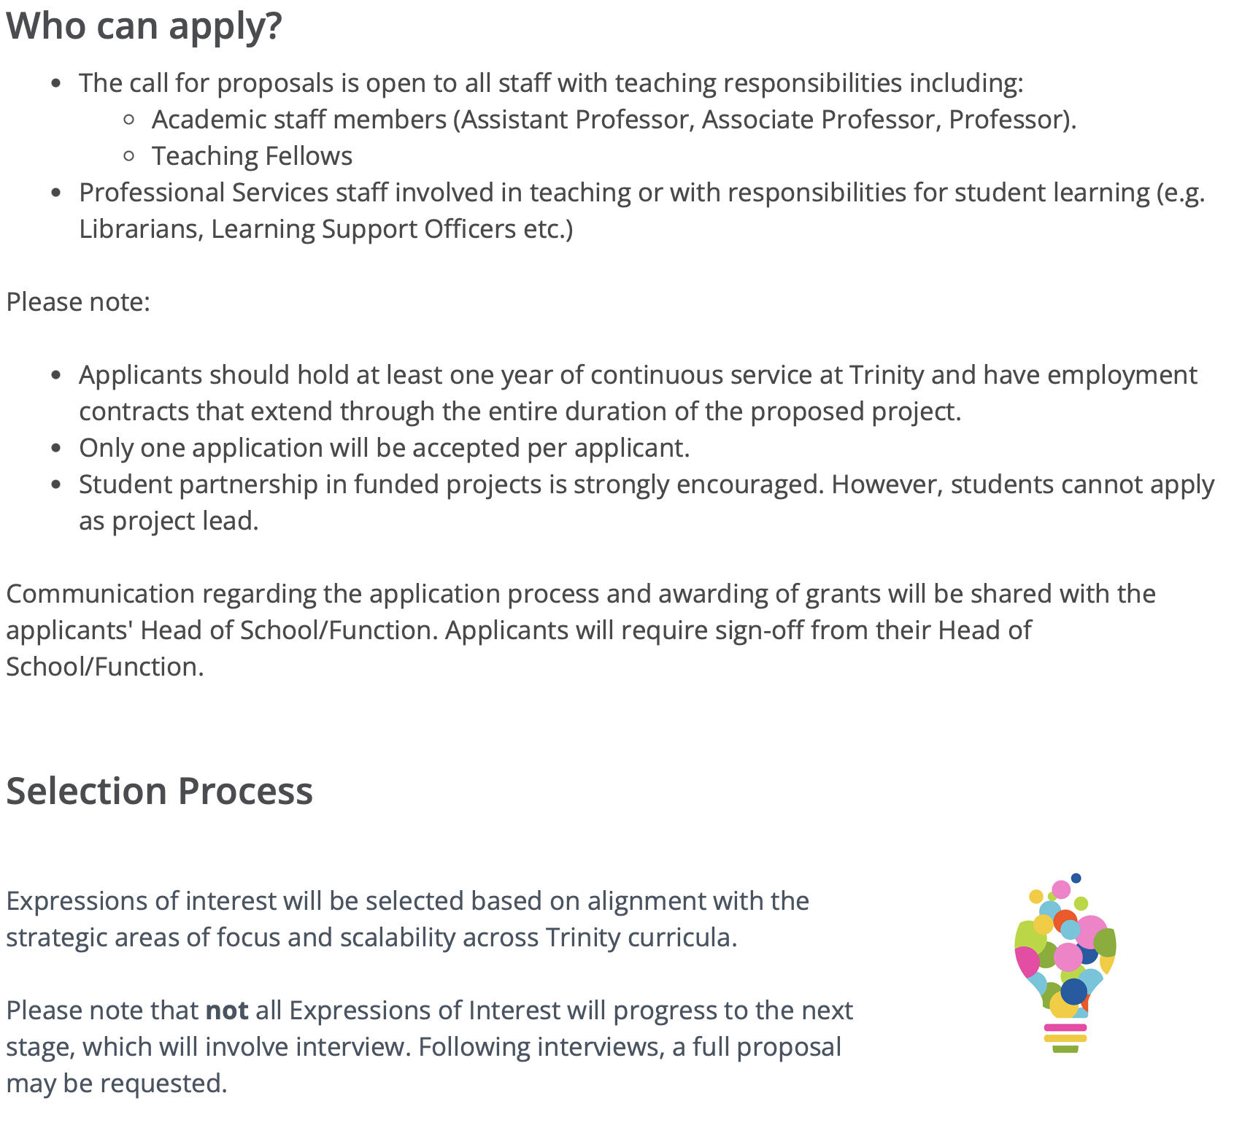

Slide 15
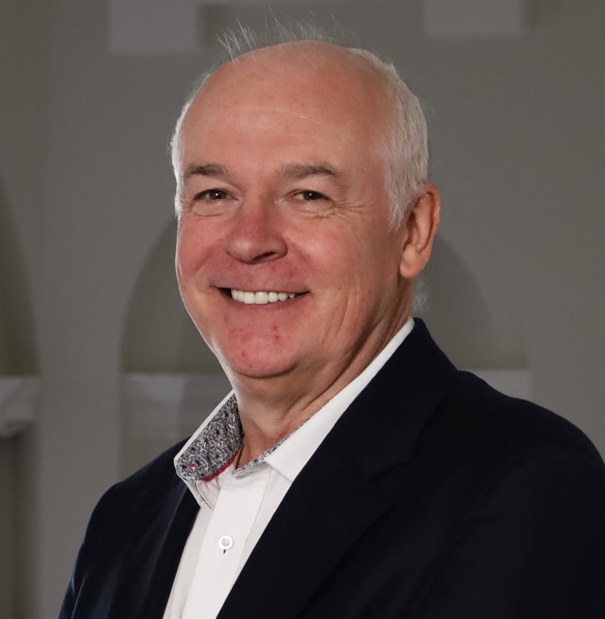
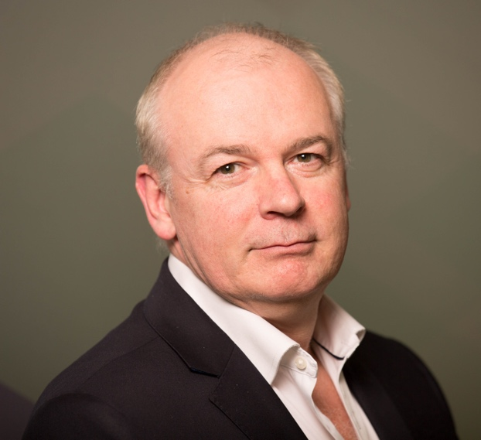
Prof. Vincent Wade
Slecture@tcd.ie
Vincent.Wade@TCD.ie
https://www.adaptcentre.ie/

