Slide 1





Partner Pack April 2018 www.askaboutalcohol.ie
The untold story:
Harms experienced in the Irish population due to others’ drinking

Slide 2
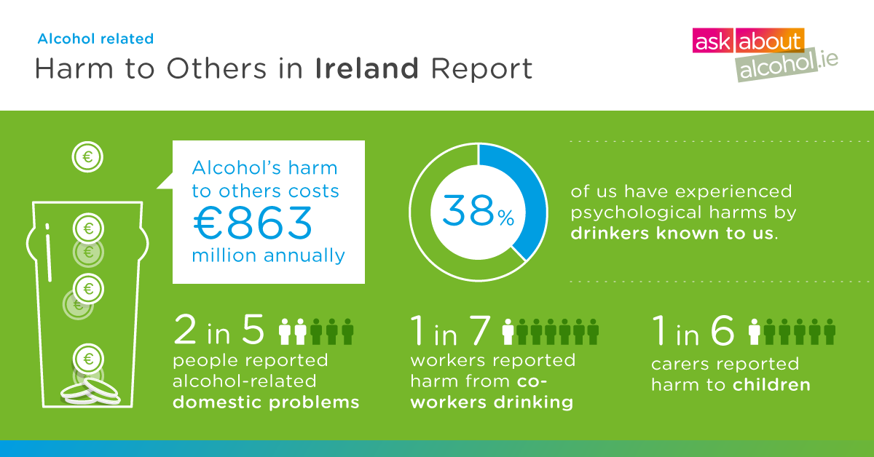
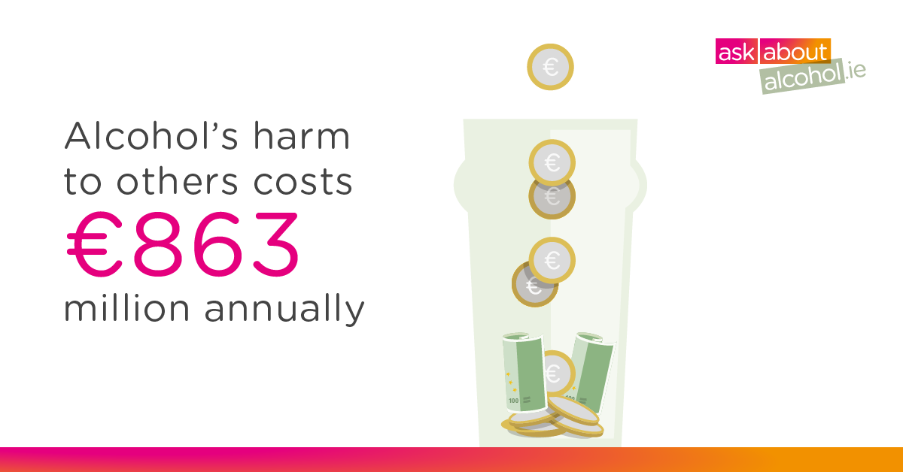
The HSE today, Monday, 16th April, launched the first dedicated Irish survey on Alcohol’s Harm to Others. “The Untold Story: Harms Experienced in the Irish Population due to Others’ Drinking” quantifies some of alcohol’s harm to others in modern Ireland. It makes very clear that preventing and reducing harm to others from drinkers is an urgent public health goal - equally as important as preventing and reducing harm to the drinker due to their own drinking.
Alcohol’s harm from other people’s drinking can affect a wide range of relationships in a person’s life – family and friends, children, work colleagues and strangers. The purpose of this report is to explore how the drinking of others can negatively impact peoples’ lives.
Key Findings from the report:
One in six carers (16%) reported that children, for whom they had parental responsibility,
experienced harm because of someone else’s drinking.
One in every two people (51%) reported experiencing harm due to strangers’ drinking in
the past 12 months.
Two in every five people (44%) reported experiencing negative consequences due to the
drinking of people they know.
Three in every five people (61%) reported having a known heavy drinker in their life.
One in seven workers (14%) reported work-related problems due to co-workers’ drinking.
The total estimated cost of AH20 as assessed in this survey was €862.75 million.

Slide 3
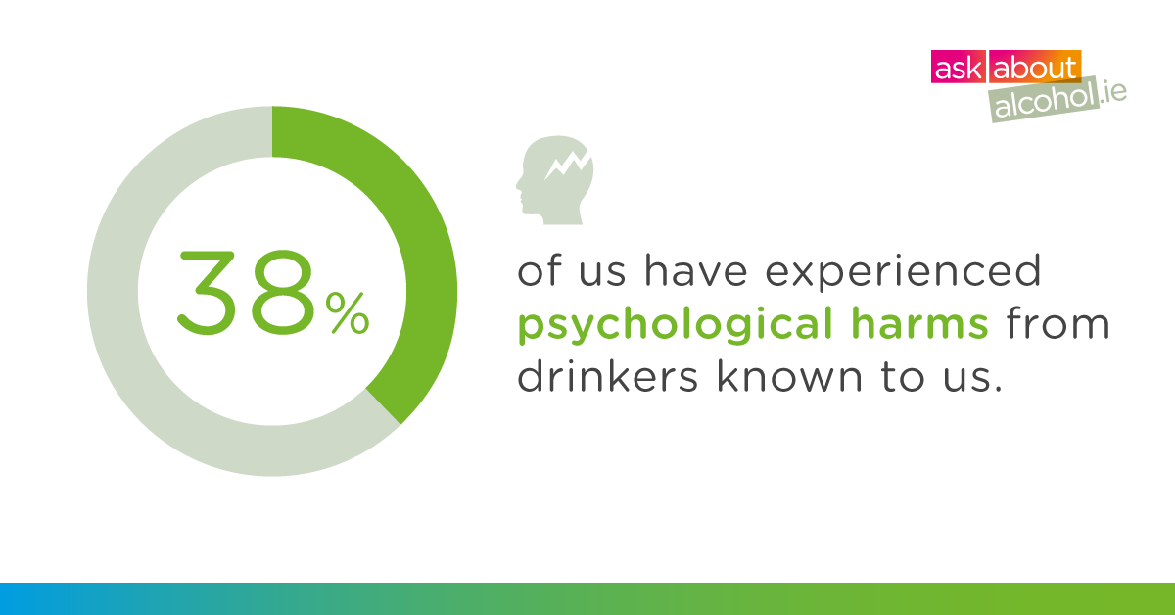
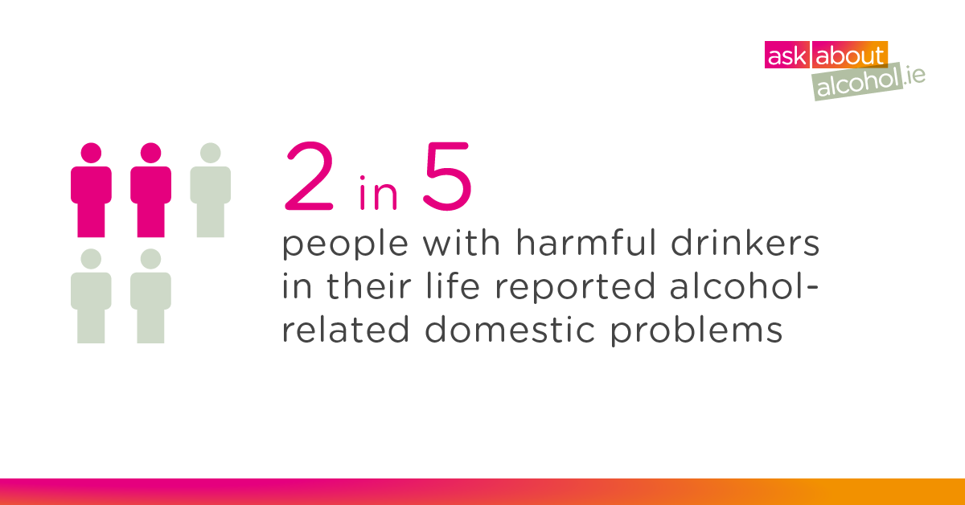
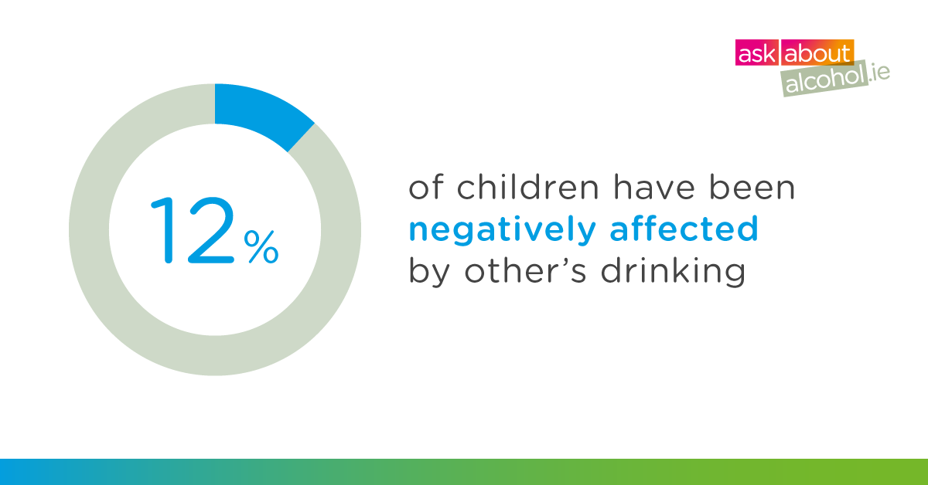
The costs estimated in this study are the tangible costs of harm to others. The survey results did not estimate the intangible cost (fear, pain, suffering, lost quality of life) of alcohol’s harm to others, but these are clearly substantial.
Harms that are prominent throughout the report include: feeling unsafe, being harassed or insulted verbally, physical harassment, stress, having less money for household expenses, sleep disturbances, being a passenger with a drunk driver, ruined belongings and having to leave home due for safety.
Children are particularly vulnerable to harm from other people’s drinking, be it within the family,
among family members or in the wider community in which they live. Overall, one in six carers (16%) reported that children, for whom they had parental responsibility,
experienced harm because of someone else’s drinking.
The full report can be downloaded here from 11am on Monday 16 April 2018

Slide 4
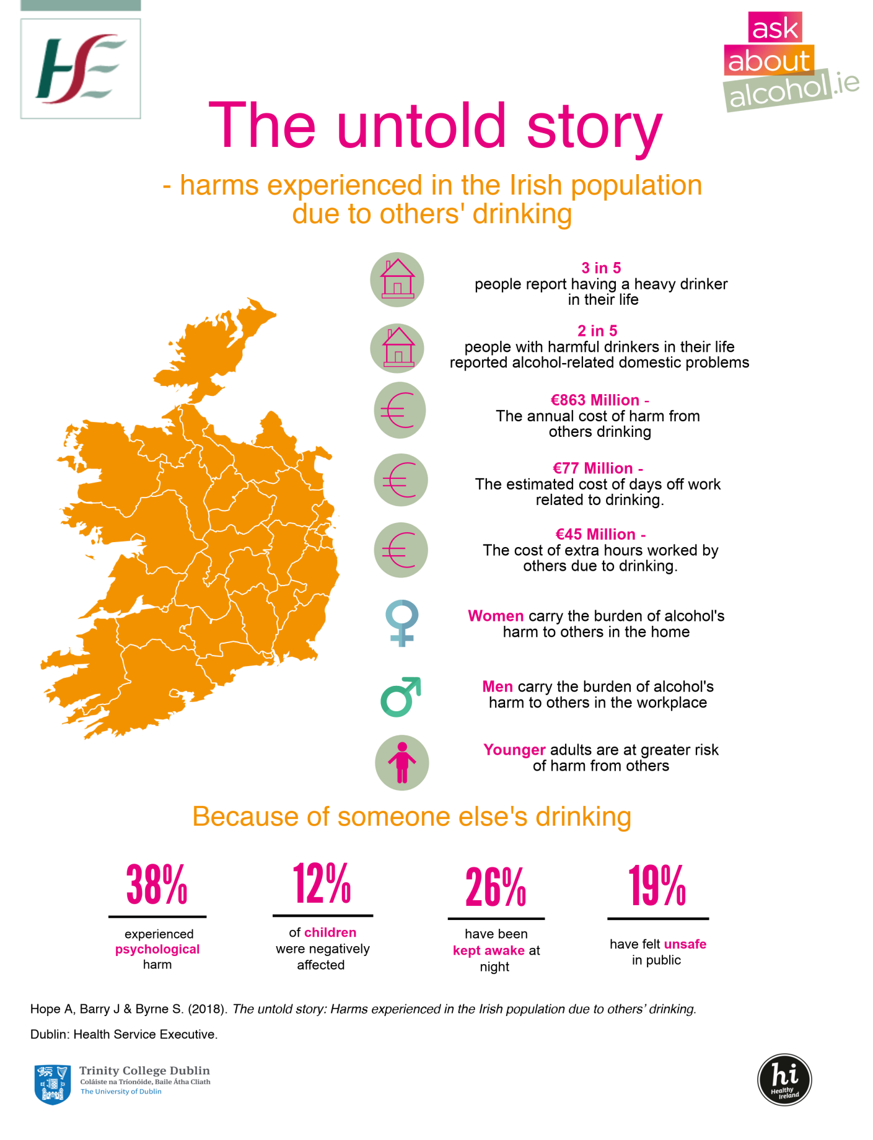
A4 Summary (right click and select Save as picture to download)

Slide 5
Suggested Social Media Messages
The serious nature of some of the harms reported can affect the health and well-being of the individual, especially when caused by known drinkers #askaboutalcohol #AH2O
The Untold Story estimates harms experienced in the Irish population due to others’ drinking” costs €863 million every year #askaboutalcohol #AH2O
3 in 5 people reported a known heavy drinker in their life #askaboutalcohol #AH2O
1in 6 carers reported harm to children from other people’s drinking #askaboutalcohol #AH2O
Reducing the harmful use of alcohol in Irish society means implementing effective public health alcohol policies. #askaboutalcohol #AH2O
The fear to personal safety due to strangers’ drinking can undermine a sense of community well-being. #askaboutalcohol #AH2O

Slide 6
Author Biographies
Dr Ann Hope
Research Associate, Department of Public Health and Primary Care, Trinity College Dublin
Ann’s background is in education, research and health promotion. She was Senior Researcher in the National University of Ireland, Galway. Dr Hope was appointed as the National Alcohol Policy Advisor and worked with the Department of Health and Children in Ireland on alcohol issues for ten years (1995-2005). As advisor, she acted as a catalyst for the development of many alcohol policy initiatives and has undertaken research on a range of alcohol issues. At international level, Ann was involved in the drafting of the WHO European Alcohol Action Plan and the Declaration on Young People. She is involved with several international alcohol research consortia.
Professor Joe Barry
Joe Barry qualified in Medicine from UCC and in Public Health from the University of London. He was Dean of the Faculty of Public Health Medicine at the Royal College of Physicians of Ireland from 1996 to 2002 and President of the Irish Medical Organisation in 2003-2004. He is Professor of Population Health Medicine at Trinity College Dublin. He is chair of the Recovery Academy of Ireland and the North Inner City local drugs and alcohol task force and is a board member of Alcohol Action Ireland.
Sean Byrne
Sean Byrne is an economist whose main area of expertise is the Economics of social issues. He has undertaken a number of studies in the Economics of health care and is the author of Costs to Society of Problem Alcohol Use in Ireland (2010) published by the Health Service Executive. Until his retirement in 2017 Sean Byrne was a lecturer in Economics in The Dublin Institute of Technology.

Slide 7
About Robin Room
Prof Robin Room, is Principle Research Fellow Centre for Alcohol Policy Research, Australia.
He is author of Foreword to the The untold story:: harms experienced in the Irish population due to others drinking and in Dublin for the official launch.
The Centre for Alcohol Policy Research (CAPR) has been led by Professor Robin Room in the last 12 years, who has worked throughout his career in the alcohol and other drug research field. Professor Room is a sociologist who has directed alcohol and drug research centres in the United States, Canada and Sweden, and now in Australia, his native country. He has been an advisor for the World Health Organization since 1975, and has received awards for scientific contributions in the USA, Sweden and Australia, the premier award in alcohol studies, the Jellinek Memorial Award for Alcohol Studies, as well as the prestigious 2012 Prime Minister’s Award for Excellence
Professor Room was a researcher at the National Alcohol Research Centre (Berkeley, California) from 1963 to 1991; he was appointed as the Scientific Director from 1977 to 1991. He was later appointed as Vice-President for Research at the Addiction Research Foundation of Ontario, Canada, from 1991 to 1998. In 1999 Professor Room was appointed professor and founding director of the Centre for Social Research on Alcohol and Drugs at Stockholm University. In March, 2006, in addition to becoming the director of CAPR, Professor Room became the Professor of Alcohol Policy Research at the School of Population Health of the University of Melbourne. In 2015, along with the shift of CAPR to La Trobe University, he became a professor at La Trobe.

Slide 8
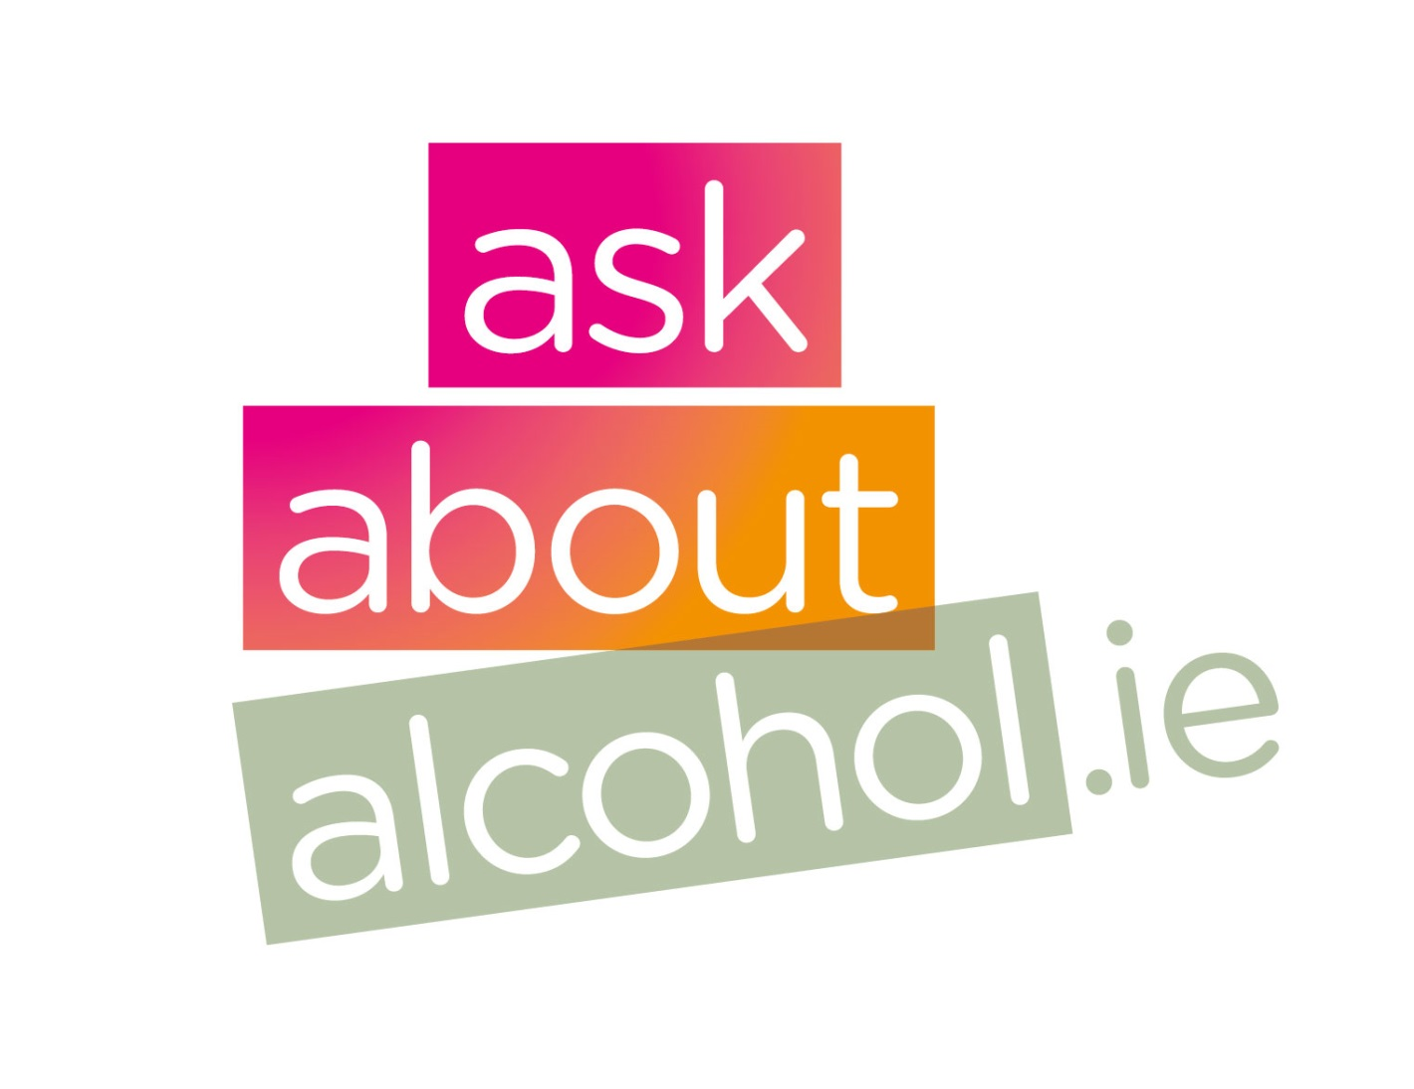
Contacts:
askaboutalcohol.ie campaign contact:
Aghna Harte, HSE, Programme and Campaigns
01-6352227
aghna.harte@hse.ie
HSE Alcohol Programme contact:
Willie Conlon, HSE Alcohol Programme
01-8659392
alcoholprogramme@hse.ie

