Slide 1


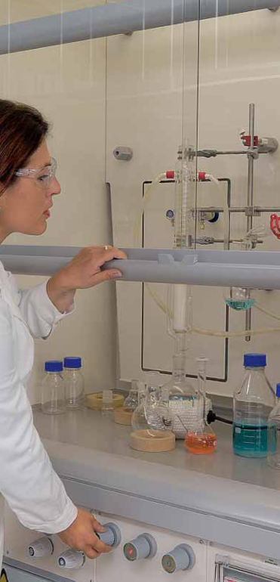
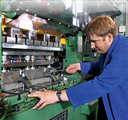
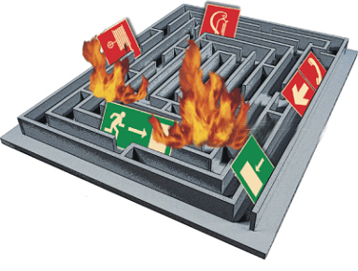


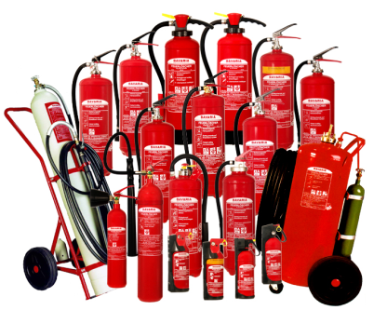
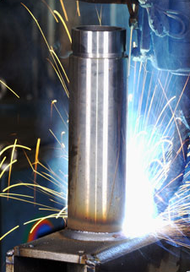

Safety Meeting
19 / 03 / 2015

Slide 2
Outline
Why again??? SAFETY AUDIT
We need to get prepared!
Rotas
Disposal
Cleaning
Tool owners
Ordering

Slide 3
Safety Audit
To-do Safety Audit
Up-to-date chemical inventory
Print out copies in lab
MSDS of all chemicals printed in lab
Risk assessments???
Behave!!!!!
Keep lab super clean.... Well, ok, CLEAN UP
Get rid of samples on benches
Get rid of empty bottles!!!!
Make sure to store chemicals appropriately
Sign in log book in prep lab
Wear personal protection equipment

Slide 4
Reminder
General Rules
Avoid spillage, in case of spillage: clean immediately
Clean up after you have finished working – every day
Do not store samples on bench or in fumehood
Label samples
Do not touch anything with potentially contaminated gloves
Lock the labs
Enforcement of Rules
Samples stored on benches or in fumehoods will be removed and discarded
Everybody is obliged to make everybody aware of a violation of the rules; Violations can be reported to Claudia After 3 records, resp. person is expelled from the lab for 2 working days

Slide 5
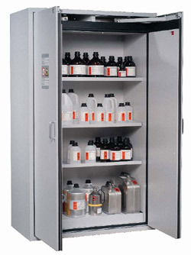
Hazardous Materials
Store Safely
The following chemicals need to be stored in dedicated storage areas / solvent presses
Flammable materials
Acids and bases (in separate compartments)
Oxidizing and reducing agents (in separate compartments)
Toxic materials
This is still the case, after materials have been mixed, e.g. most of your samples need to be stored safely as well!
Storage cabinets in CRANN and SNIAM
CLEAR CUPBOARDS!!!!!!!

Slide 6
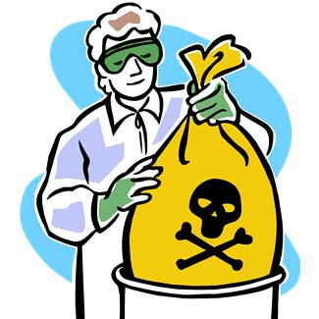
Hazardous Materials
Dispose Safely
Liquids: dispersions of nanomaterials in the respective chlorinated and non-chlorinated waste cans
Sharps bin – pipette tips, pasture pipettes and contaminated glass wear
All gloves and solvent contaminated tissue to be put in a PE bag
Glass solvent bottles – rinse with Acetone, stick label over the Haz symbols and remove names. Bring to glass recycling beside
the Hamilton.
Rota for disposing haz waste. Check when you are on duty, others are allowed to remind… IN TIME!

Slide 7
Hazardous Materials
Disposal Rota
2015 | Jan | Feb | March | April | May | June | July | Aug
Seb
Conor
Auren
Damien
James
David
Andrew
Ivan
Adam CRANN
Peter CRANN

Slide 8
Lab Cleaning Outline
General Points
Everyone is responsible for clearing their own mess
Samples should not be stored in fume cupboard
Work area should be cleaned when you finish working
Lab | Raman | UV-Vis | AFM | Sample Prep | CRANN 2.29 | CRANN 2.28 | Fitz
Supervisor | Lily |  | Tom | Claudia | Zahra | Keith | Umar
Cleaners | Peter |  | Seb | Auren + Andrew + Ivan | Damien + David | James | Conor + Adam

Slide 9
Lab Cleaning Outline
Responsibilities - Supervisors
In general, ‘keep an eye on’ the tidiness of the lab
Check lab regularly
Weekly initially
Less often if found to be consistently tidy
Complete checklist, ensure actions are completed
Ensure cleaners are doing their jobs
Act as point of contact for any issues

Slide 10
Lab Cleaning Outline
Responsibilities - Cleaners
Keep lab tidy. This includes:
Work spaces clear of clutter and samples
BenchKote replaced if needed
Glassware cleaned and cleared from sink area
Ensure consumables adequately stocked - gloves, vials, paper towels, pipette tips etc.

Slide 11
Tool Owners
Routine maintenance, arrange repairs/replacements, training
Tool | Location | Owner
UV Vis | SNIAM -1.33 | Seb
Raman | SNIAM -1.34 | Keith and Claudia
AFM | SNIAM -1.32 | Claudia
PL | SNIAM -1.34 | Claudia
Electric rig | SNIAM -1.32 | Tom
Centrifuges | SNIAM -1.30 / CRANN 2.28 | Keith
Pipettes | Various | Lily and Zahra
Sonic tips and baths | Various | Damien
Balances | SNIAM -1.30 / -1.32 | Lily
Filtration | CRANN 2.29 | Zahra
Ovens | Various | Tom
Tensile tester & chillers | Fitz | Umar
Cross Flow | CRANN 2.28 | Keith
IGC | CRANN 2.29 | Auren and Ivan
pH meter | CRANN 2.29 | Zahra
Longroom contact | Longroom | Damo and Claudia

Slide 12
Ordering Consumables

